Slide 1
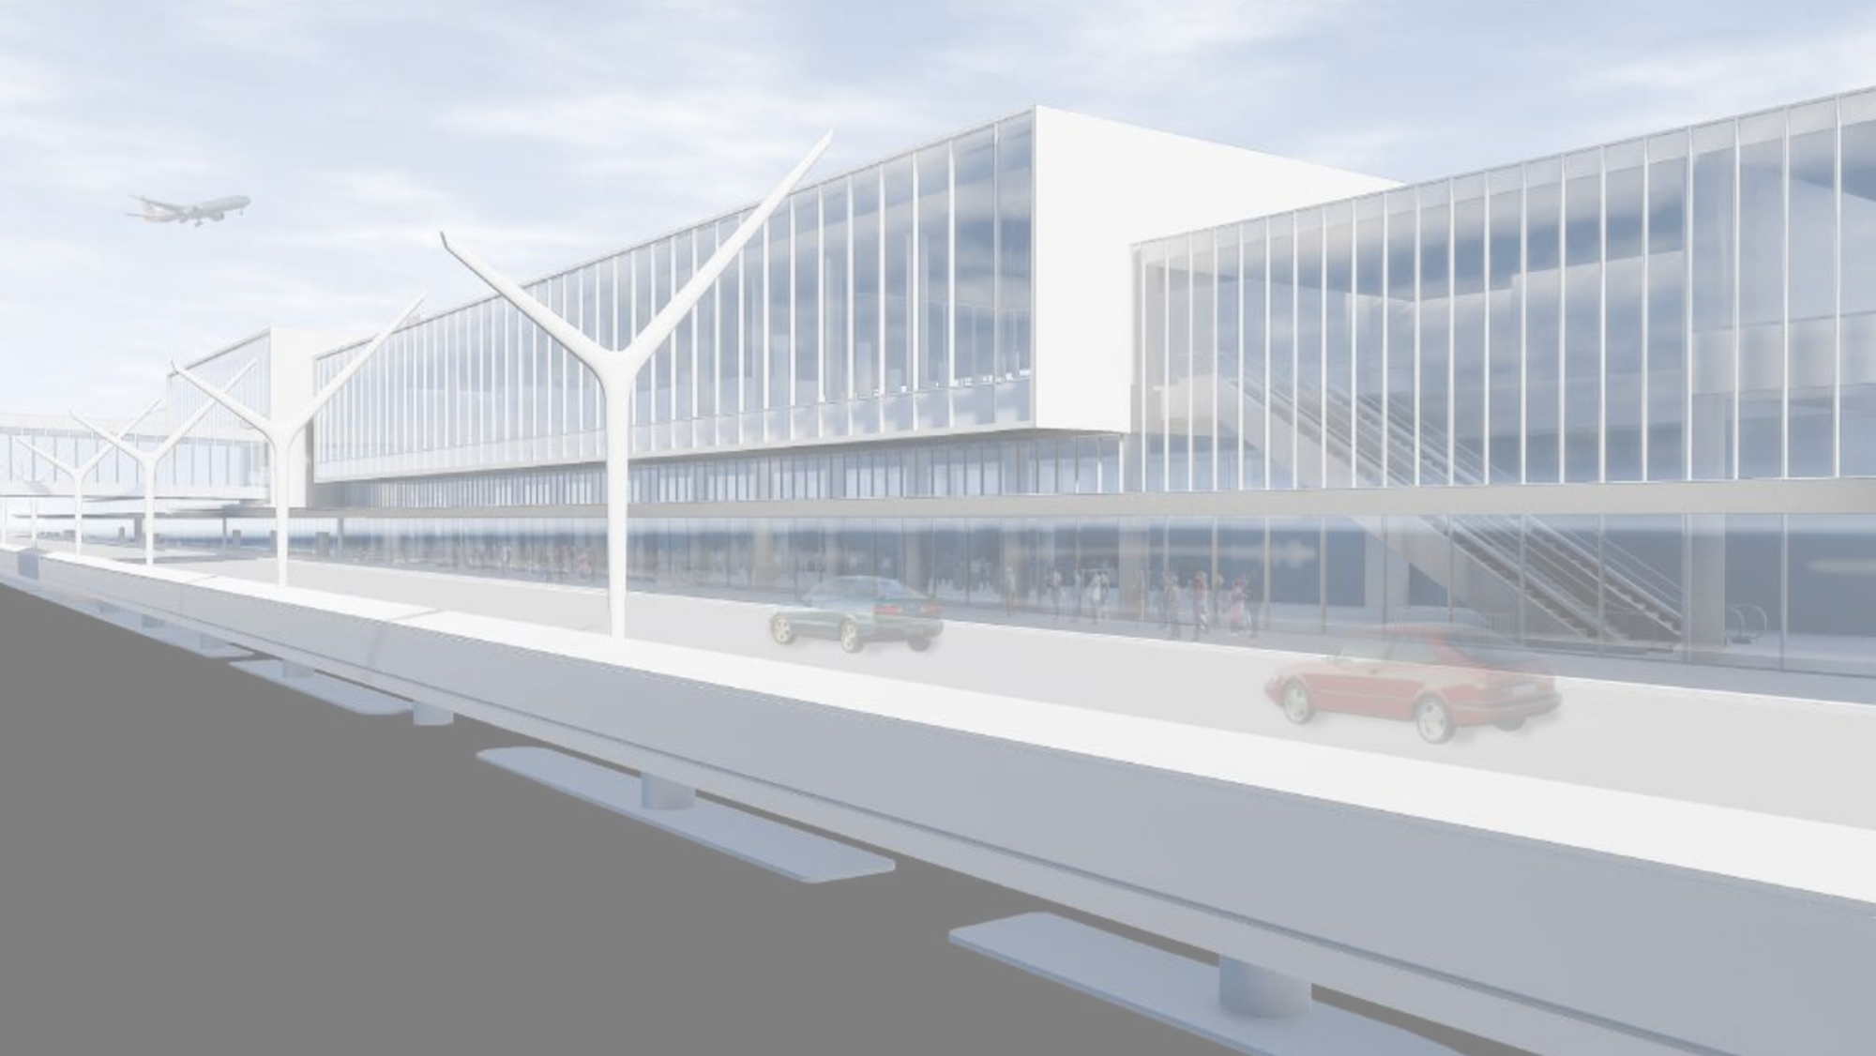

FIELD ORG CHART EXAMPLE
POSTION TITLE
ROLE (SCOPE OF WORK)
POSITION START DATE
POSTION TITLE
ROLE (SCOPE OF WORK)
POSITION START DATE
POSTION TITLE
ROLE (SCOPE OF WORK)
POSITION START DATE
POSTION TITLE
ROLE (SCOPE OF WORK)
POSITION START DATE
POSITION TITLE
ROLE (SCOPE OF WORK)
POSITION START DATE
POSITION TITLE
ROLE (SCOPE OF WORK)
POSITION START DATE
POSITION TITLE
ROLE (SCOPE OF WORK)
POSITION START DATE
POSITION TITLE
ROLE (SCOPE OF WORK)
POSITION START DATE
POSITION TITLE
ROLE (SCOPE OF WORK)
POSITION START DATE
POSITION TITLE
ROLE (SCOPE OF WORK)
POSITION START DATE
POSITION TITLE
ROLE (SCOPE OF WORK)
POSITION START DATE
POSITION TITLE
ROLE (SCOPE OF WORK)
POSITION START DATE
POSITION TITLE
ROLE (SCOPE OF WORK)
POSITION START DATE
POSITION TITLE
ROLE (SCOPE OF WORK)
POSITION START DATE
POSITION TITLE
ROLE (SCOPE OF WORK)
POSITION START DATE
POSITION TITLE
ROLE (SCOPE OF WORK)
POSITION START DATE
POSITION TITLE
ROLE (SCOPE OF WORK)
POSITION START DATE
POSITION TITLE
ROLE (SCOPE OF WORK)
POSITION START DATE
POSITION TITLE
ROLE (SCOPE OF WORK)
POSITION START DATE
POSITION TITLE
ROLE (SCOPE OF WORK)
POSITION START DATE
POSITION TITLE
ROLE (SCOPE OF WORK)
POSITION START DATE
POSITION TITLE
ROLE (SCOPE OF WORK)
POSITION START DATE
POSITION TITLE
ROLE (SCOPE OF WORK)
POSITION START DATE
POSITION TITLE
ROLE (SCOPE OF WORK)
POSITION START DATE
POSITION TITLE
ROLE (SCOPE OF WORK)
POSITION START DATE

Slide 2
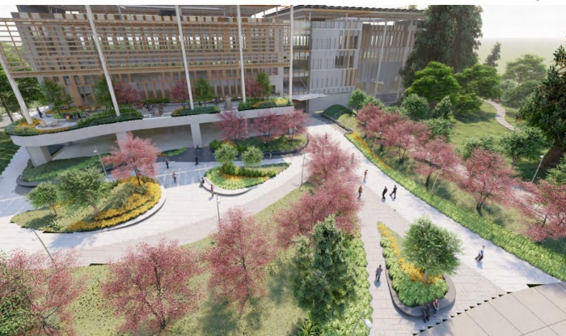
FIELD ORG CHART #1
(START OF CITY HALL CONSTRUCTION)
POSITION TITLE
ROLE (SCOPE OF WORK)
POSITION START DATE
POSITION TITLE
ROLE (SCOPE OF WORK)
POSITION START DATE
POSITION TITLE
ROLE (SCOPE OF WORK)
POSITION START DATE

Slide 3
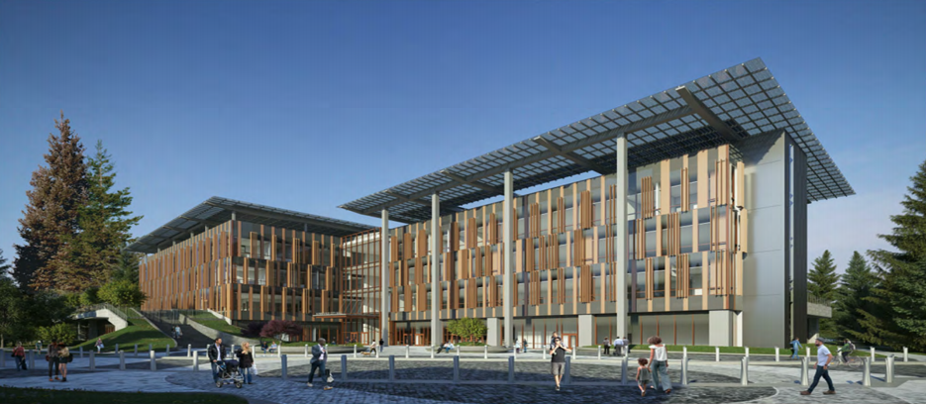
FIELD ORG CHART #2
(START OF EOC FINISHES)
POSITION TITLE
ROLE (SCOPE OF WORK)
POSITION START DATE
POSITION TITLE
ROLE (SCOPE OF WORK)
POSITION START DATE
POSITION TITLE
ROLE (SCOPE OF WORK)
POSITION START DATE

