Slide 1

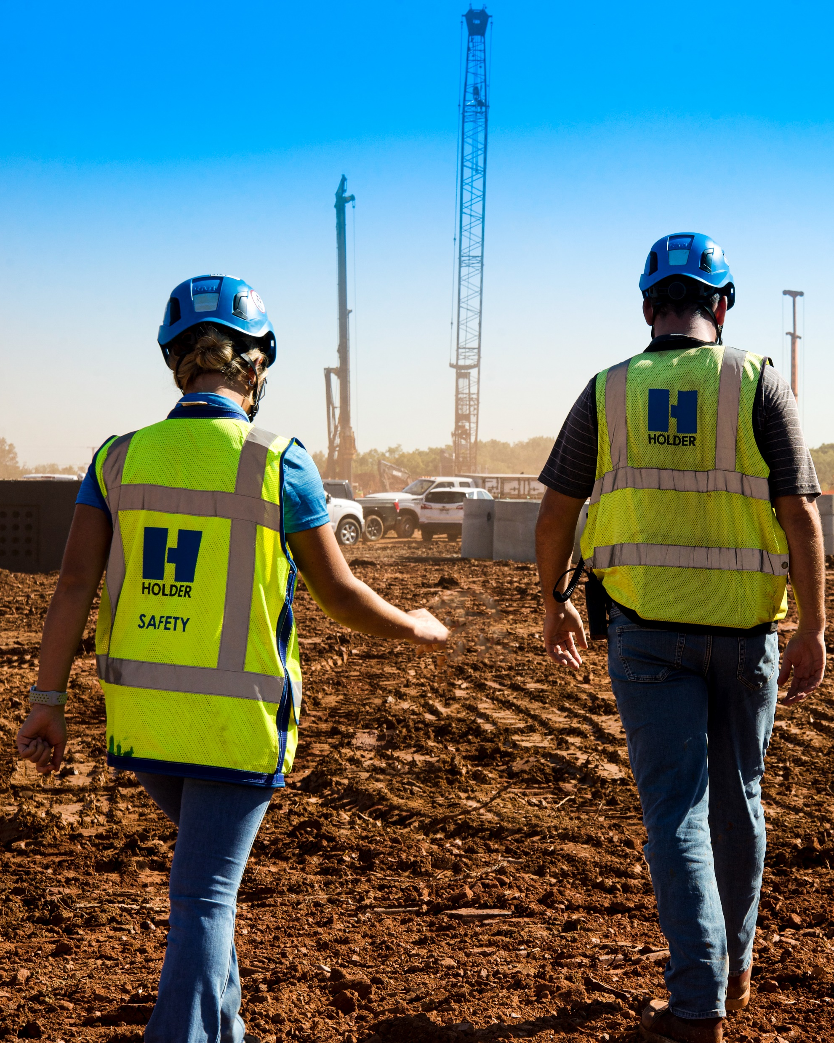
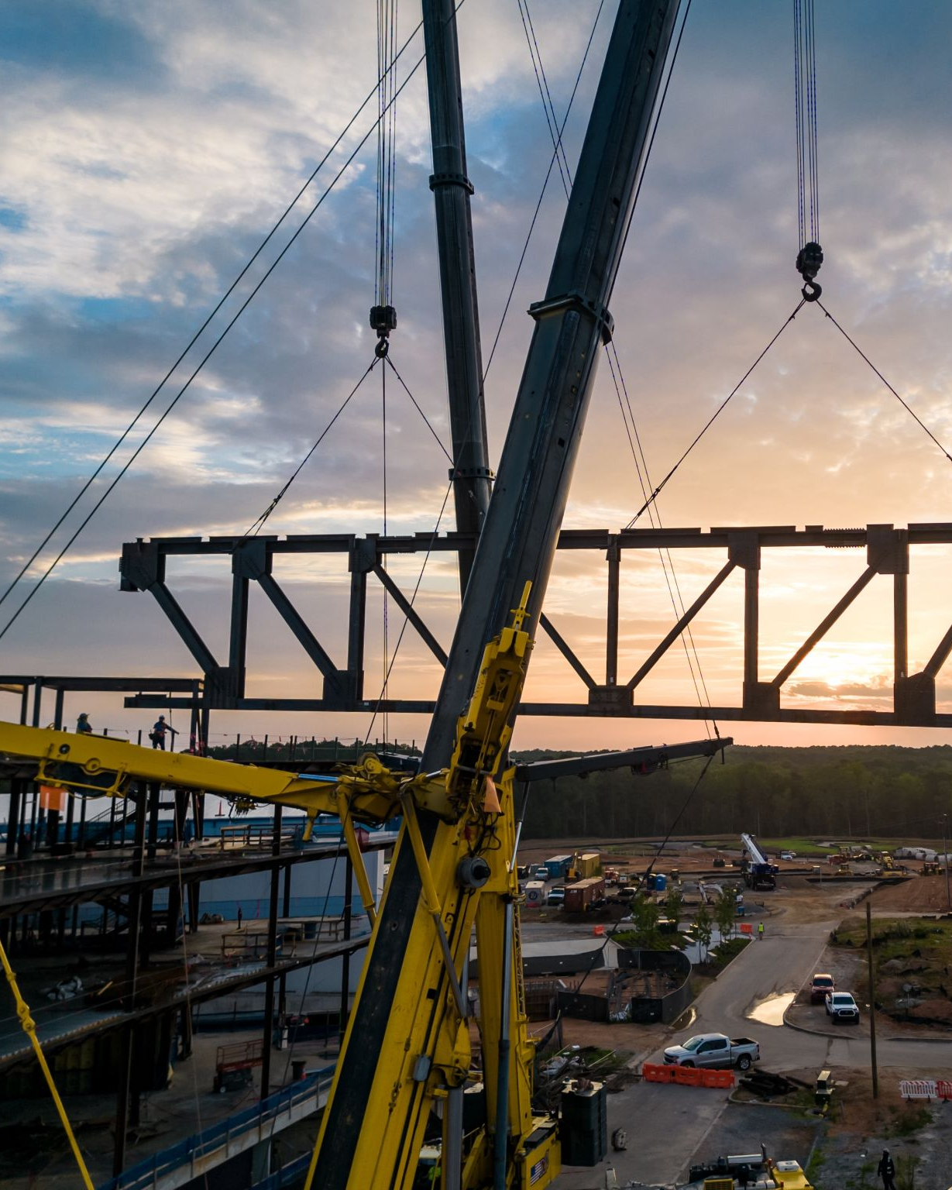

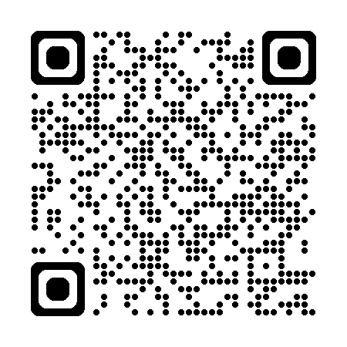
Build Your Legacy
Travel the US ● Defined Career Path ● Competitive Pay and Benefits ● Inclusive ● Family Culture
Scan to view current opportunities at Holder!

Slide 2
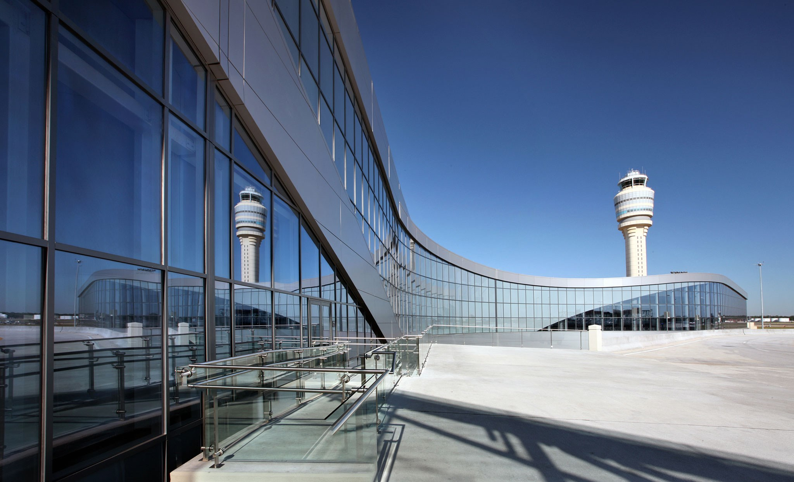
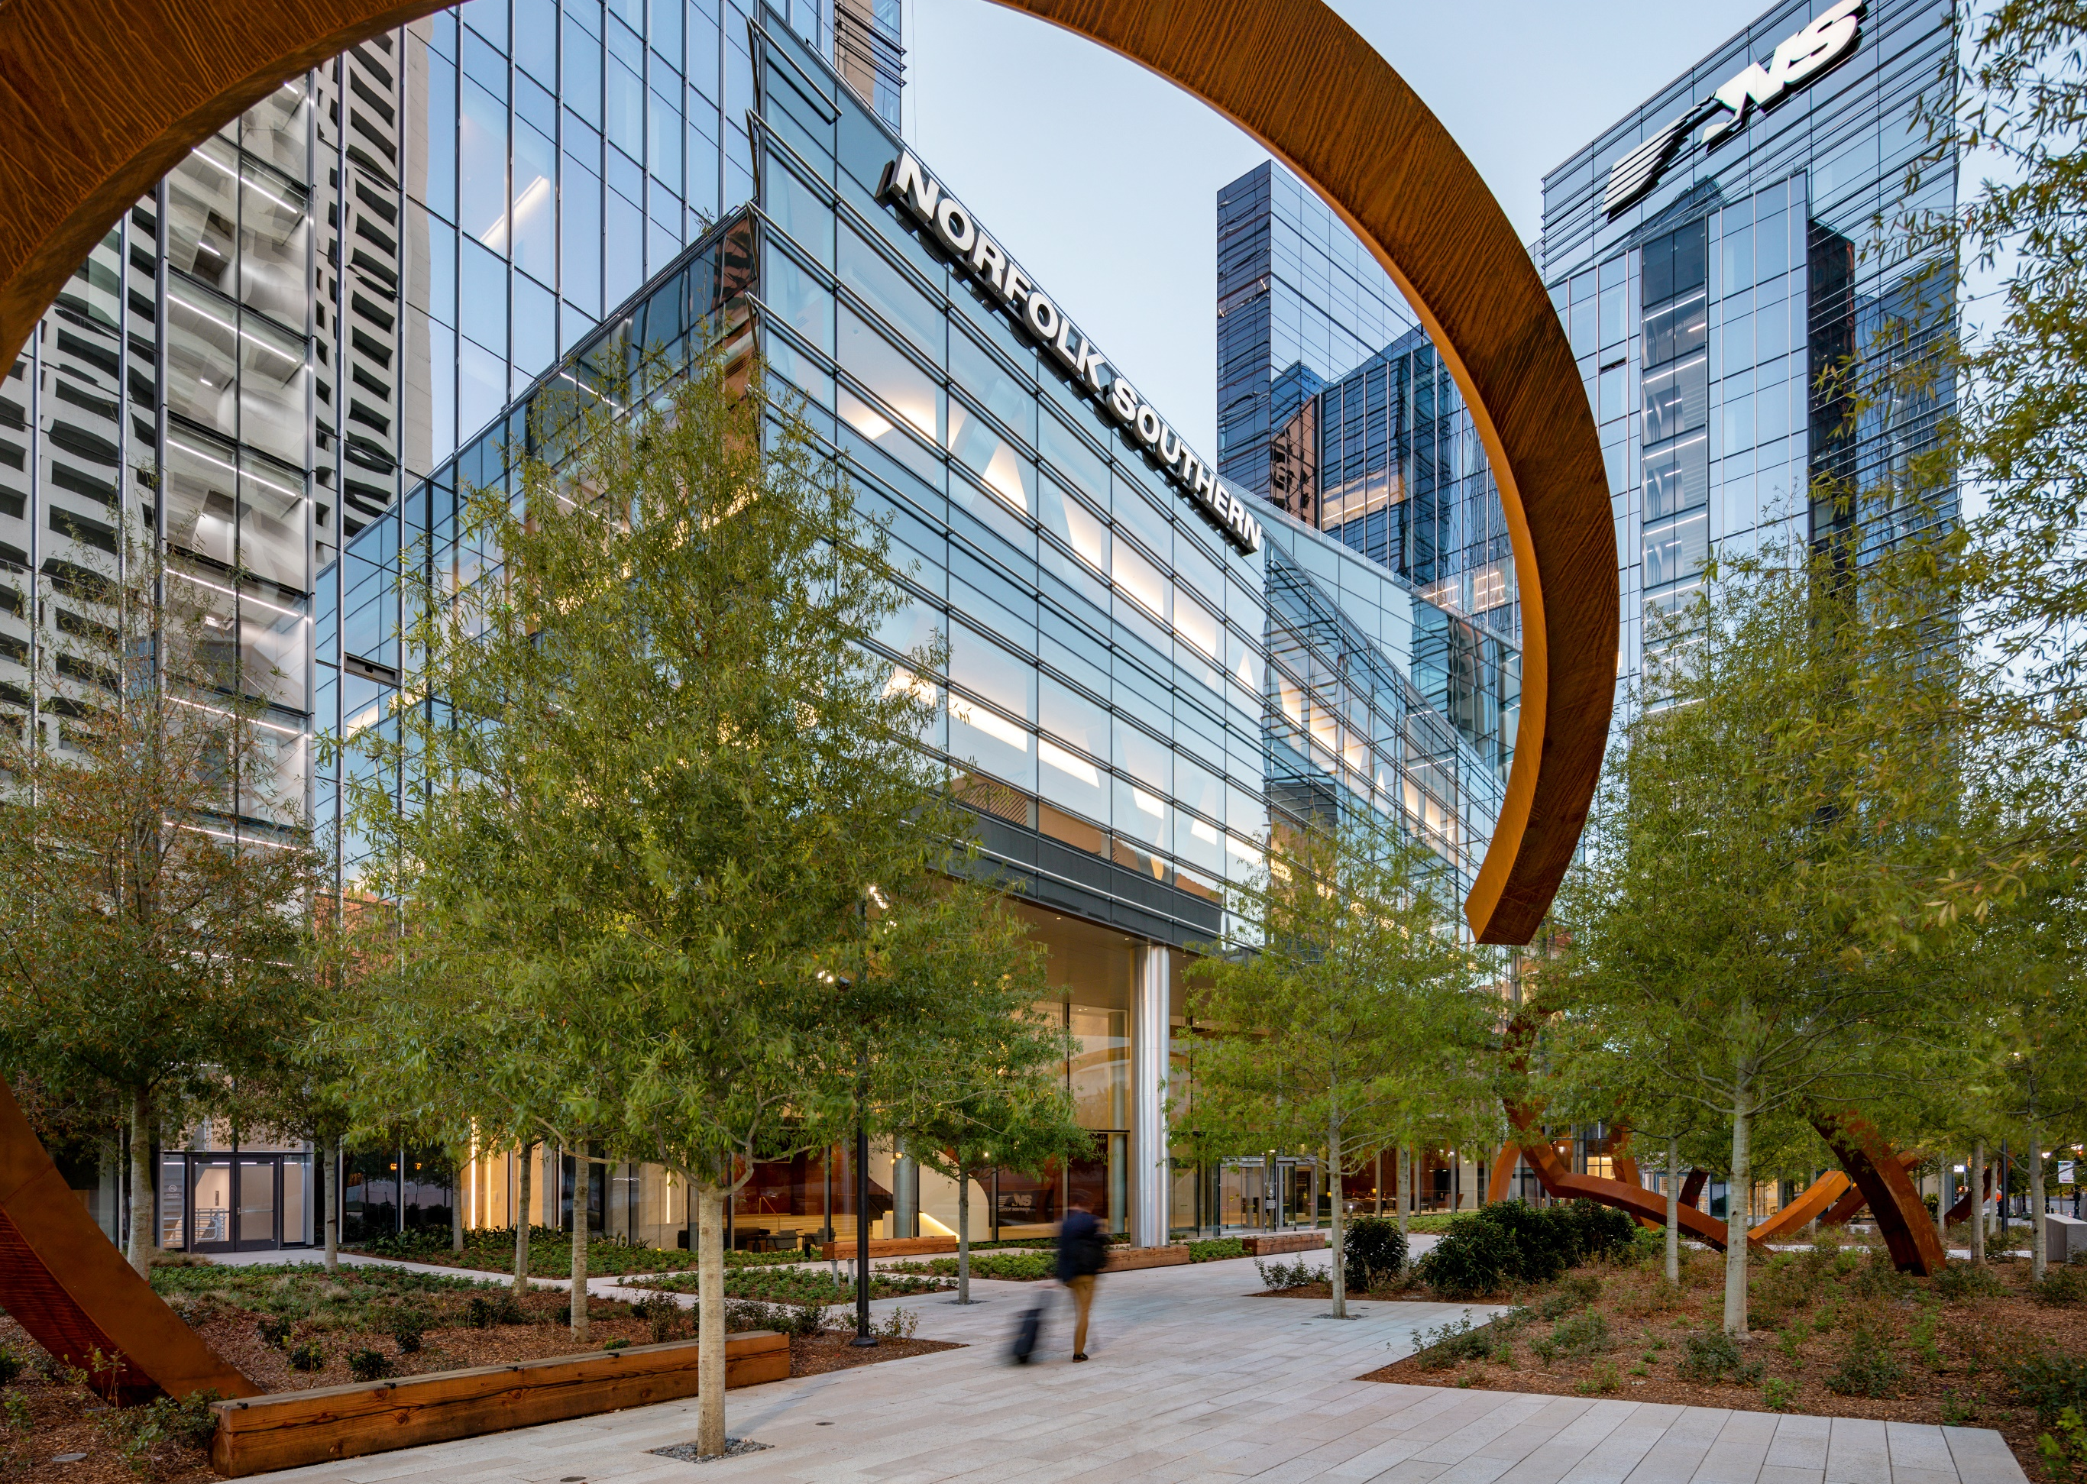
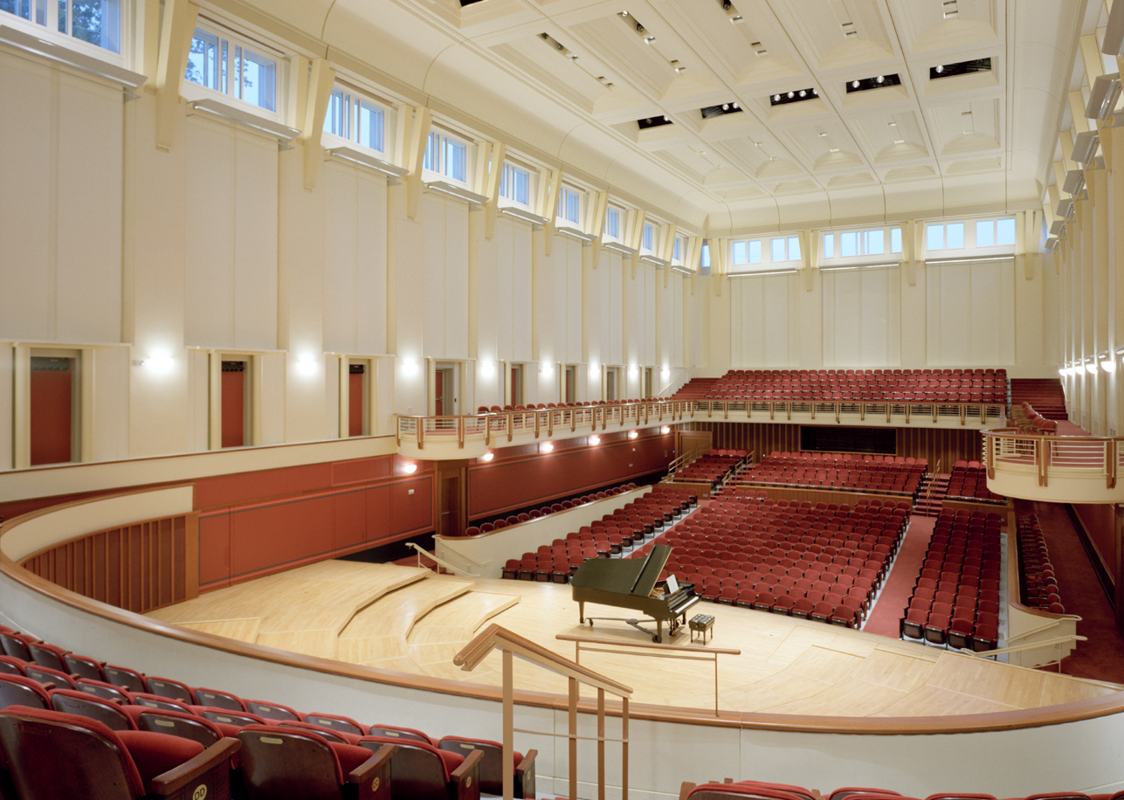
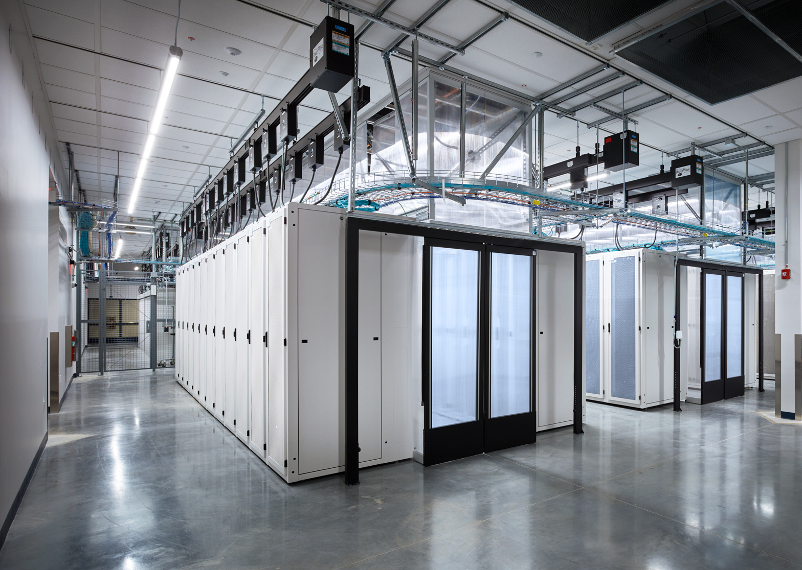
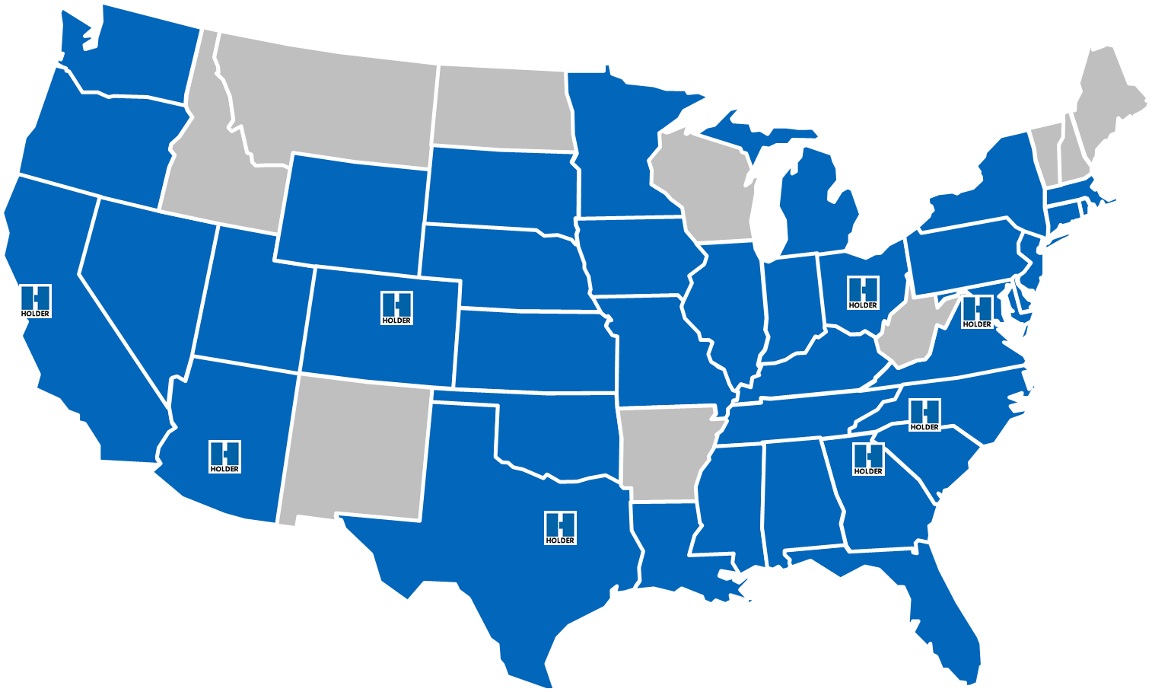
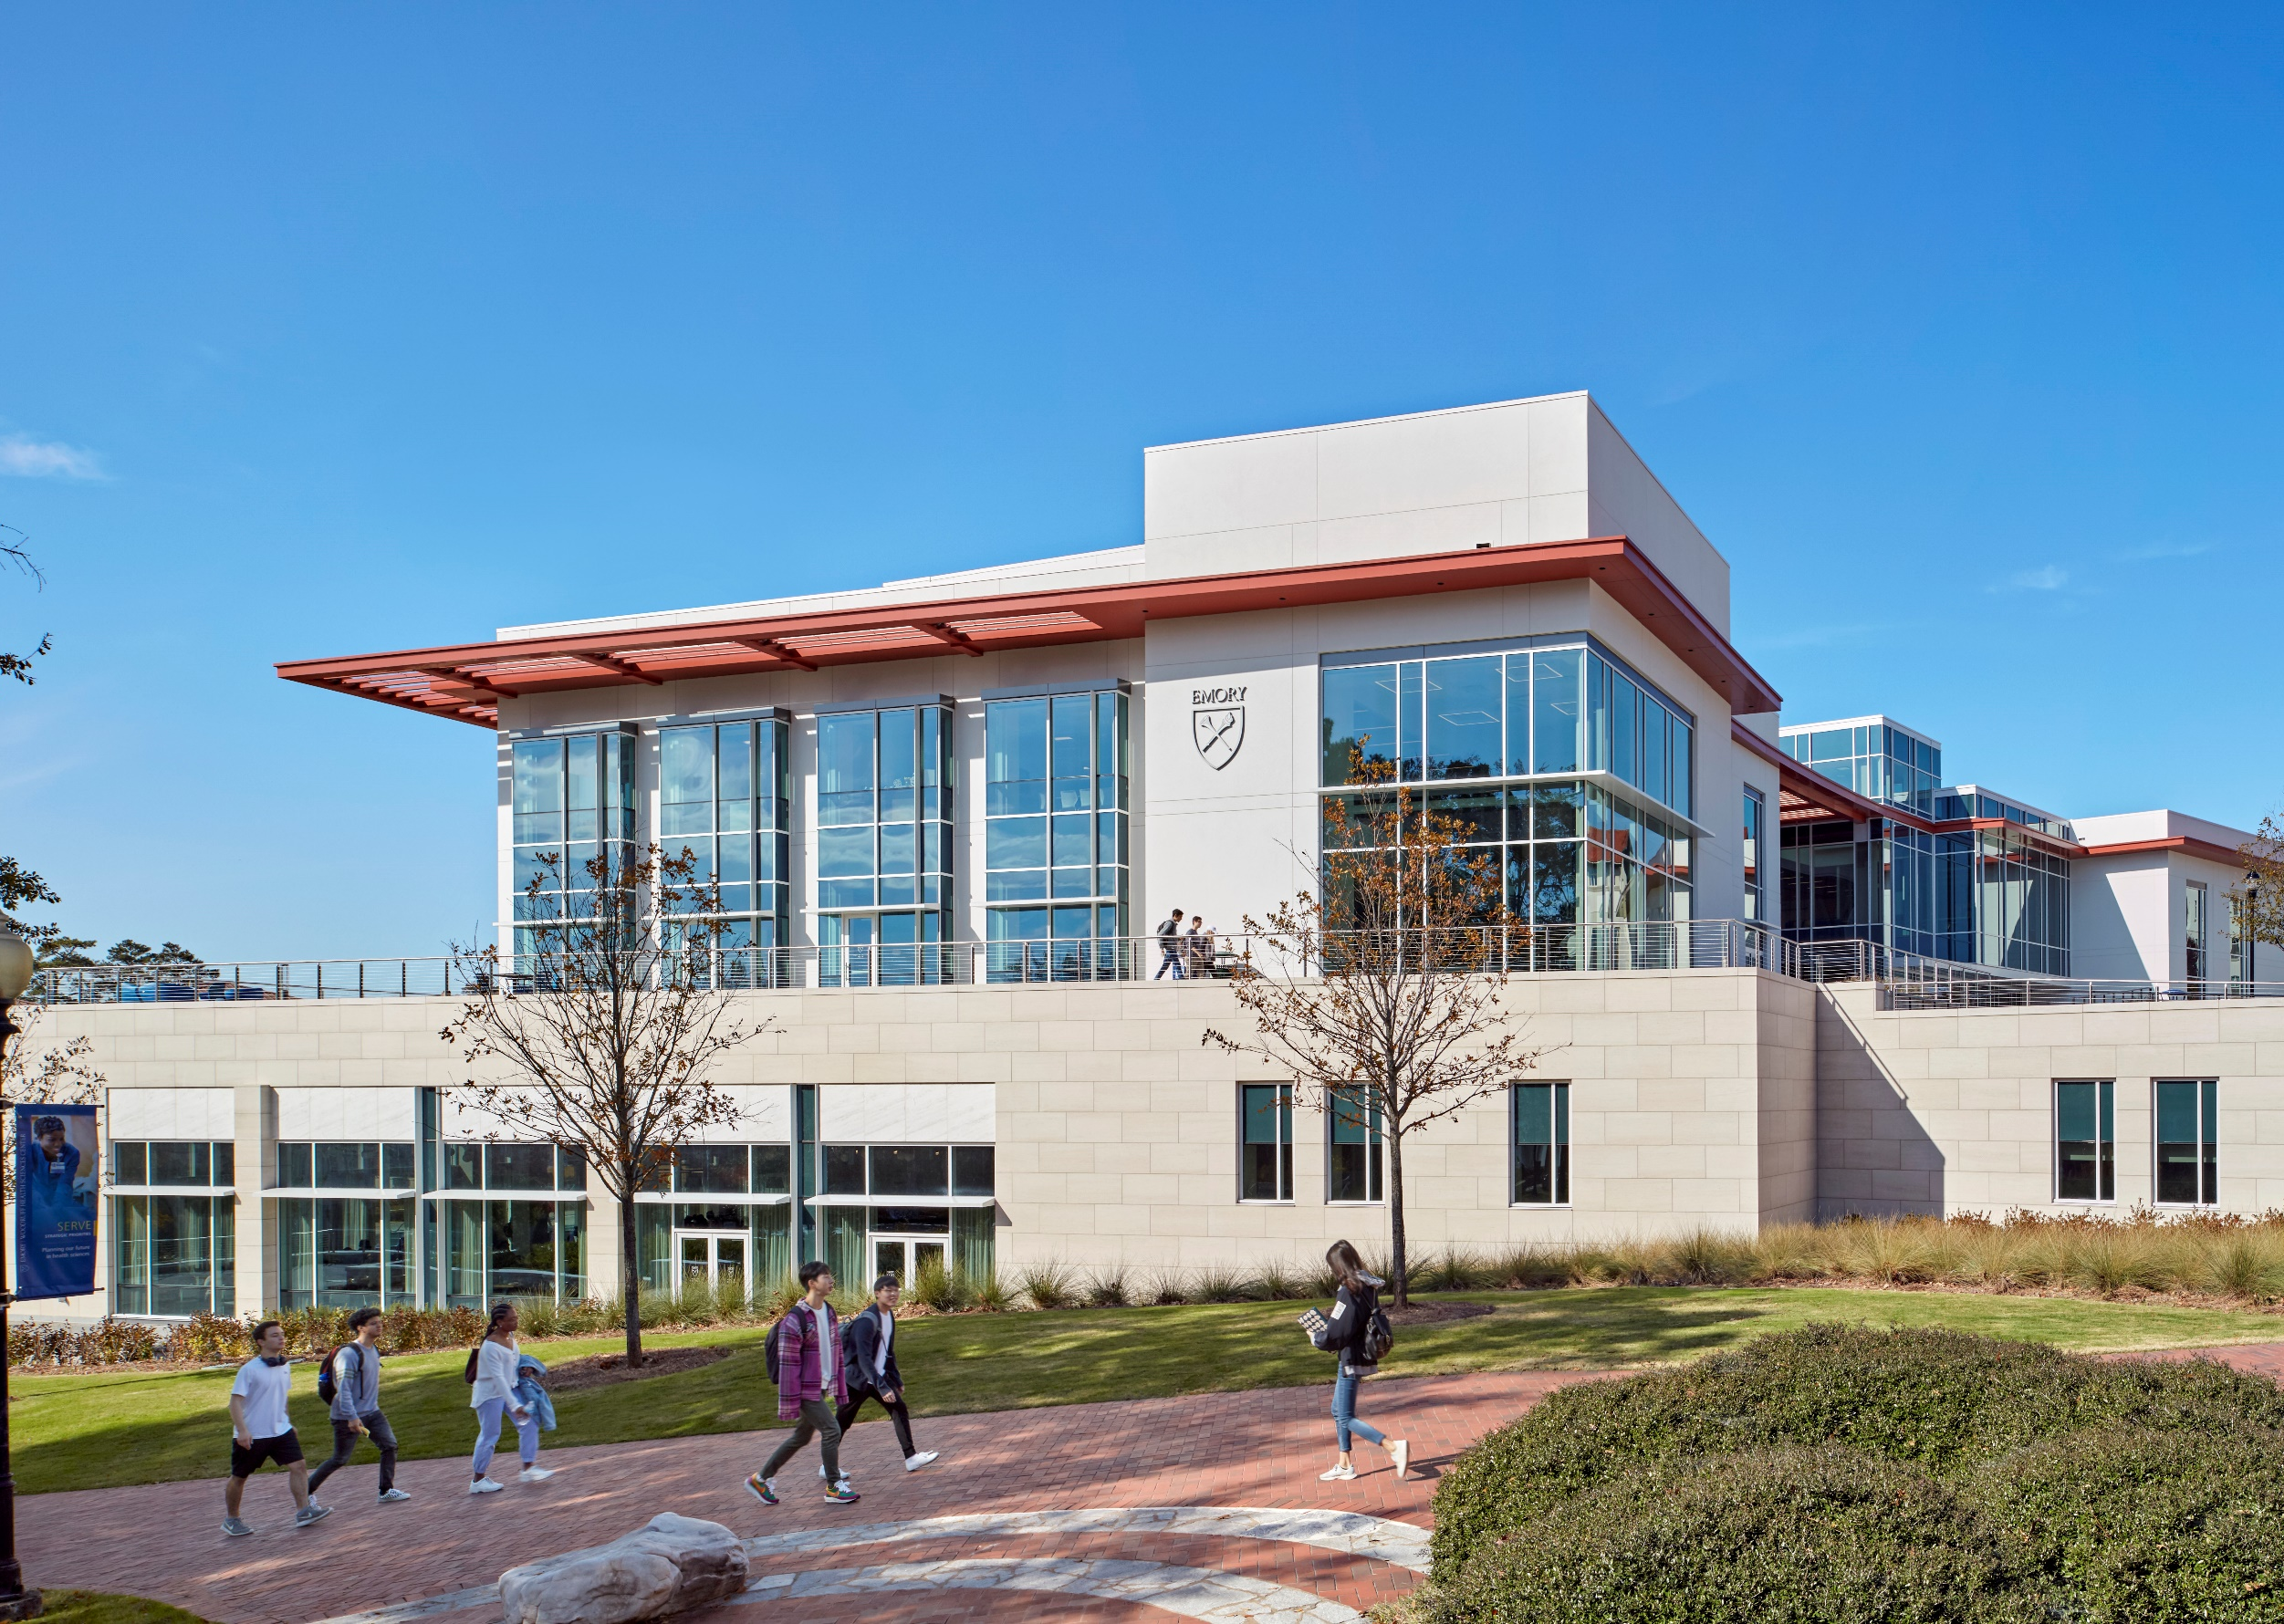
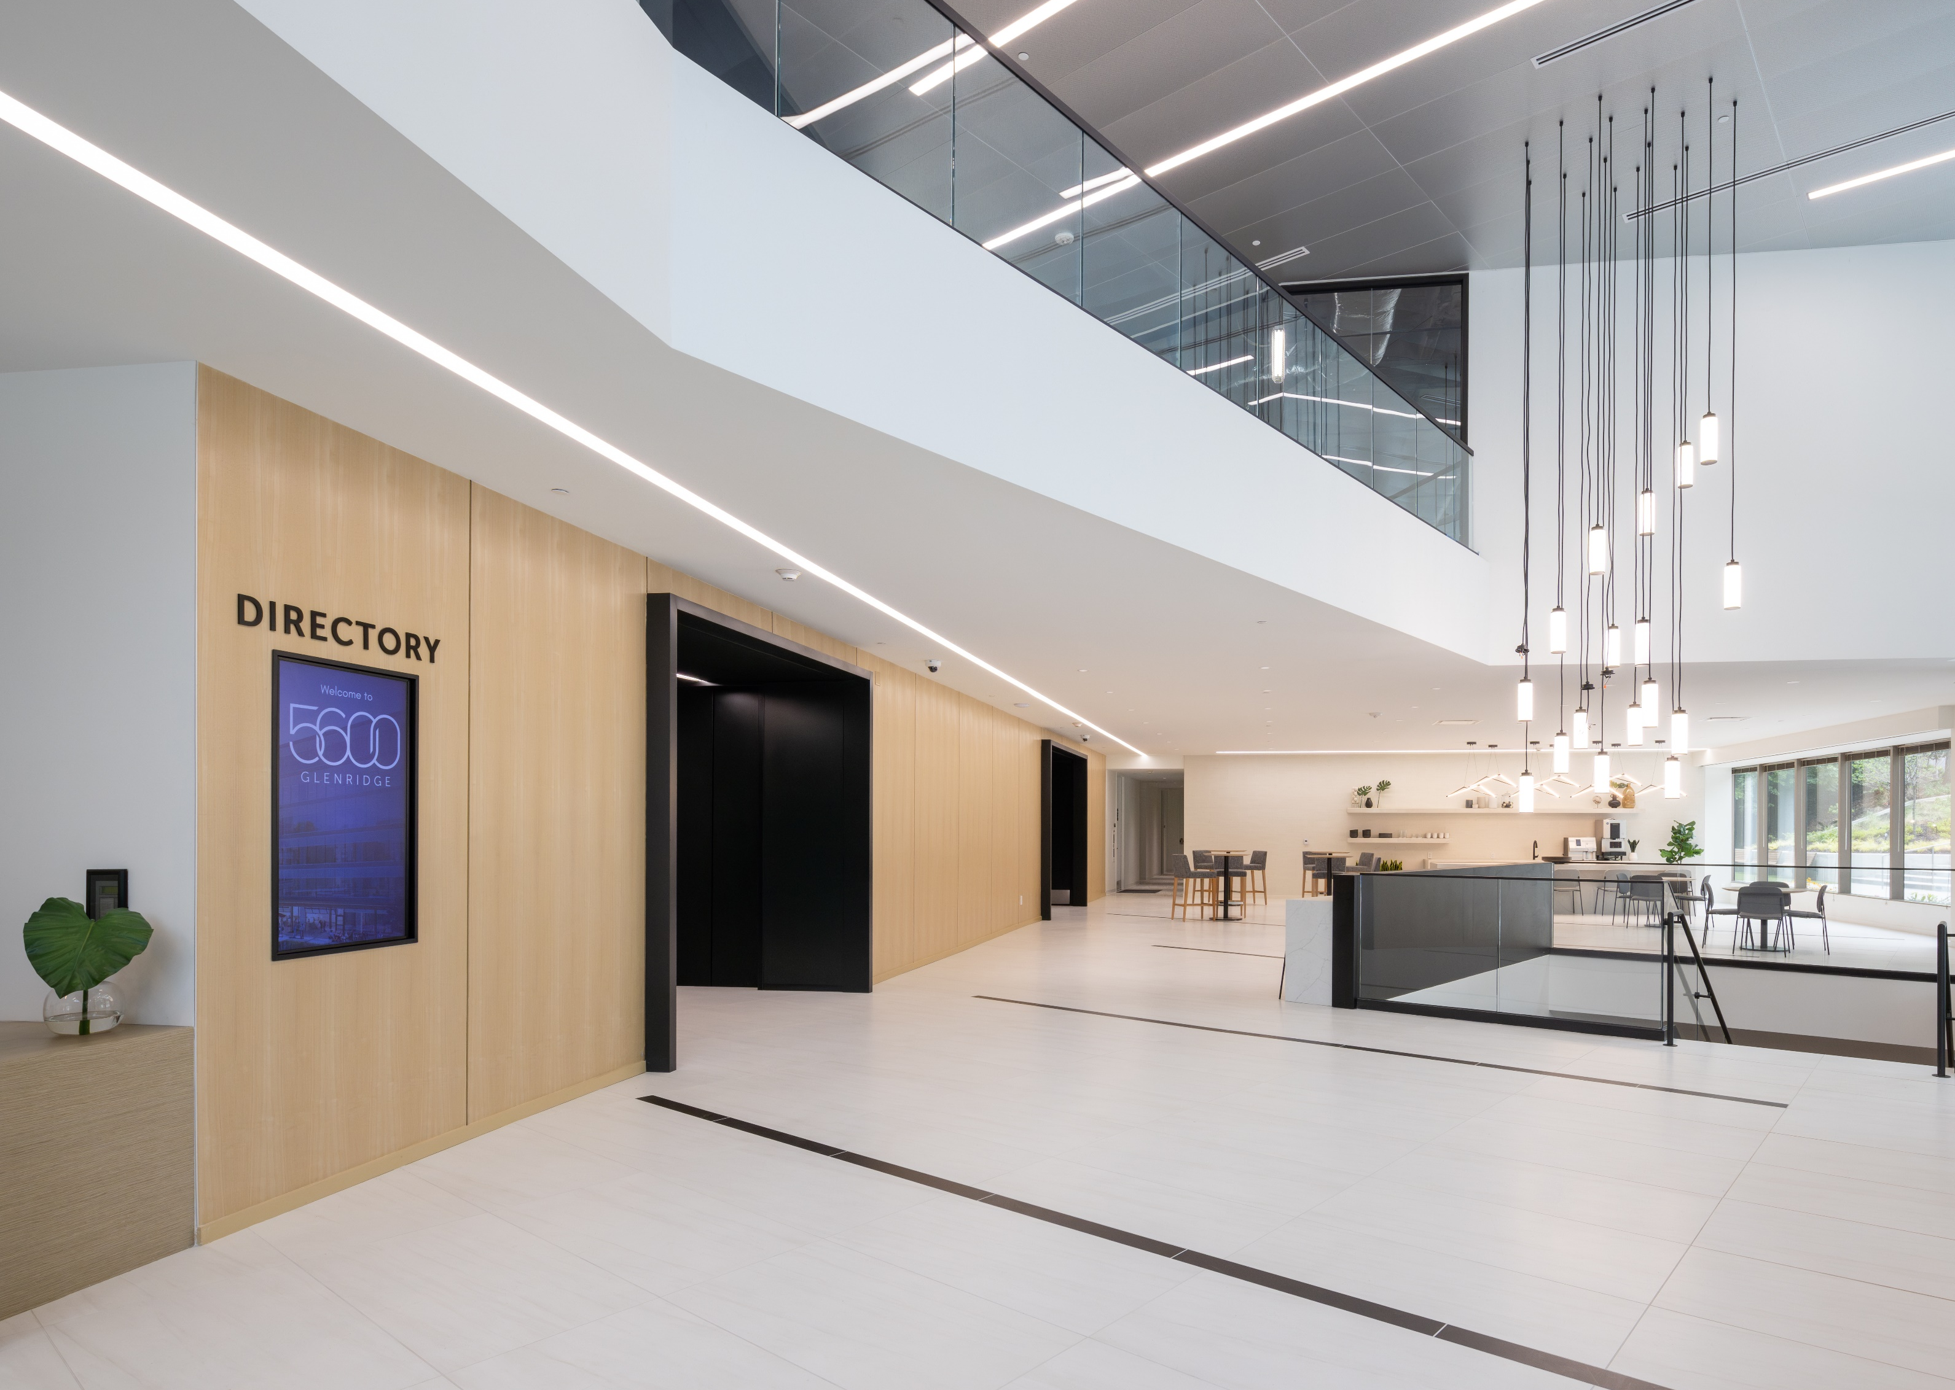
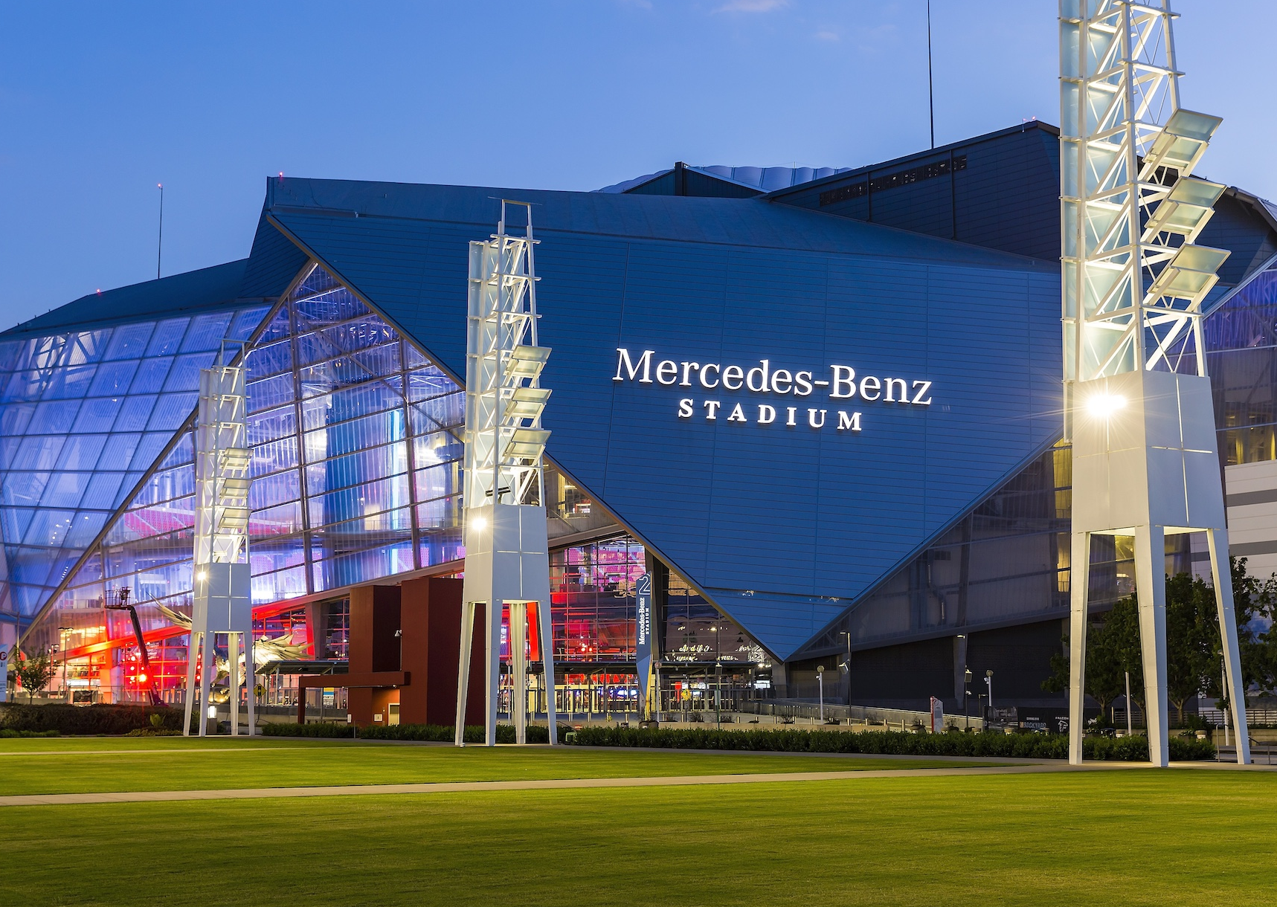
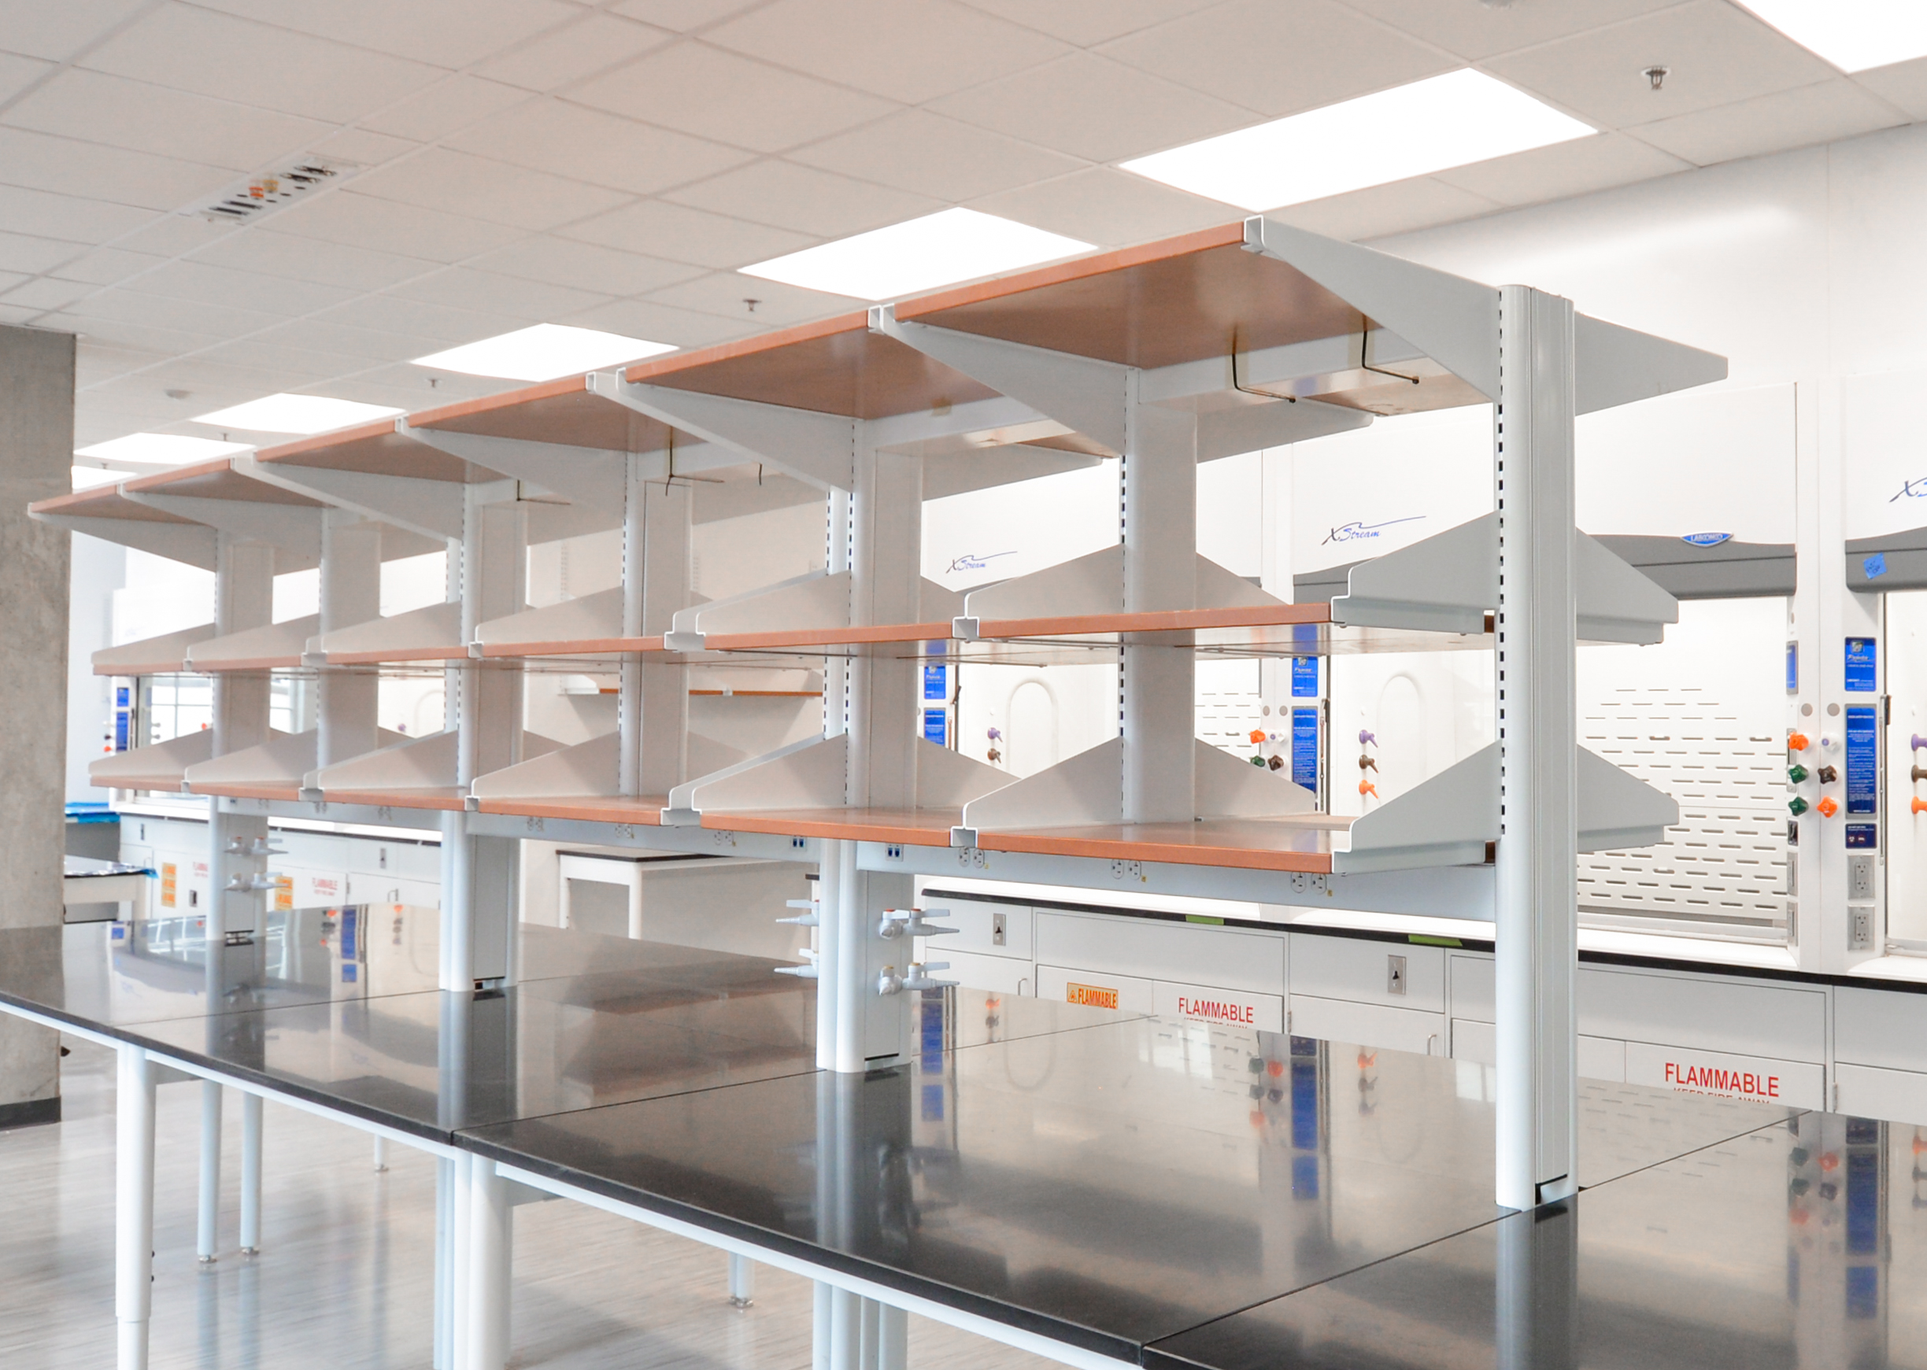
About Us
Since 1960, we’ve built a reputation for excellence. Our most valuable resources are our people who carry forth our traditions, values, and long-standing reputation for performance. We give our people opportunities to grow, to develop, to lead. To fail, and to learn from our failure. To win, and to take pride in our collective success. We build exceptional careers and a shared legacy.
Offices
Markets
Aviation & Transportation
Corporate & Commercial
Cultural & Performing Arts
Data & Telecom
Higher Education
Interiors & Adaptive Reuse
Opportunities
Holder offers numerous departments and job functions with clear paths to advancement in the following areas:
Public Assembly & Hospitality
Science & Technology
Project Management Field Supervision Sustainable Services Preconstruction Scheduling | MEP | Building Technology Virtual Design & Construction Planning & Design Support Safety & Risk Management Quality
Atlanta | Charlotte | Columbus | Dallas | Denver | Phoenix | San Jose | Washington DC

